Slide 1
Hazardous Materials Regulations and Resources
An overview of legal requirements under the Emergency Planning and Community
Right-to-Know Act

Slide 2
EPCRA Documents & How to Comply Manual
http://www.neflepc.org/

Slide 3
Agenda
EPCRA Sections 301, 302, and 303 - Planning for Chemical Emergencies
EPCRA Sections 311 & 312 – Hazardous Chemical Inventory Reporting
EPCRA Section 304 and CERCLA Section 103 Release Notification
EPECRA Section 325 & 326 - Enforcement & Civil Actions

Slide 4
Acronyms
CAS #: Chemical Abstract Service Number
CERCLA: Comprehensive Environmental Response, Compensation and Liability Act
DEM: Division of Emergency Management
EPCRA: Emergency Planning Community Right-to-Know Act
EHS: Extremely Hazardous Substance
LEPC: Local Emergency Planning Committee
SDS: Safety Data Sheet
RQ: Reportable Quantity
SERC: State Emergency Response Commission
TPQ: Threshold Planning Quantity

Slide 5
History
EPCRA was passed in response to 2 major events
Bhopal, India Disaster
December, 1984
Methyl Isocyanate – 500,000+ exposed (2000+ dead)
Worst Industrial Accident in History
Institute, West Virginia
August, 1985
Methylene Chloride & Aldicarb Oxime
134 people to hospital
Notes:
Union Carbide India Limited pesticide plant; over 500,000 people were exposed. Estimates vary on the death toll, but the official immediate deaths were 2,259. Other deaths in the weeks following are anywhere from 3,000 to 16,000. Injuries included 558,125 with 38,478 temporary partial injuries and 3,900 severely and permanently disabling injuries.

Slide 6
Federal & State Legislation
Superfund Amendments and Reauthorization Act of 1986 (SARA Title III)
Florida EPCRA, 1988 – FL Statute: Chapter 252, Part II

Slide 7
EPCRA
Subchapter A: Emergency Planning and notification of a hazardous materials incident (Sections 301 – 304)
Subchapter B: Reporting of hazardous chemical inventories and toxic release inventory reports (Sections 311 – 313)
Subchapter C: Administration, enforcement, & trade secret protection (Sections 321-330)

Slide 8
EPCRA Purpose
Encourages and requires coordination between industry, government, and the public
Requires information be accessible to the public
Authorizes penalties for not complying with EPCRA
Empowers private citizens groups to file enforcement lawsuits for failure to comply

Slide 9
Section 301- SERC
Establishes Organizational Framework
Establishes the State Emergency Response Commission
Group of Stakeholders (Public, Private, & Gov’t)
Meets Quarterly
Policy Group
Staffed by the Florida Division of Emergency Management (FDEM)

Slide 10
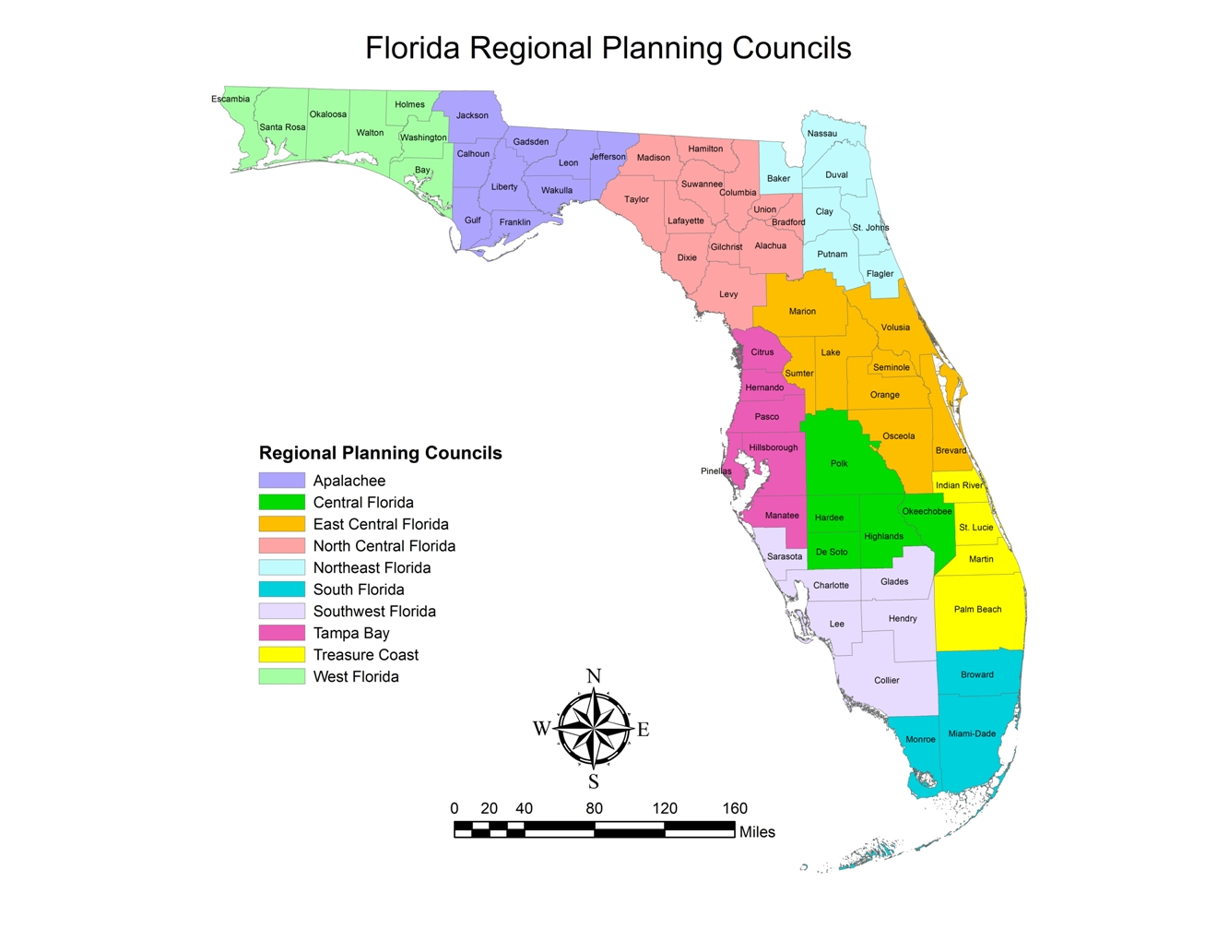
Section 301 – LEPC

Slide 11
Statutory/Contractual
Services
Hazards Analysis Site Visits
LEPC Organizational Functions
Tier II Reporting
LEPC HazMat Response Plan
Technical Assistance
Training/Exercises for Public and Private Entities
Public Outreach
“How to Comply” Workshops
E-Plan Electronic Tier II Filing

Slide 12
Section 302 Substances & Notification
Purpose of Section 302 is to establish and identify a list of substances and gather information on facilities of most concern for emergency planning and response
That list is known as the EPA’s “List of Lists”
Focus on Extremely Hazardous Substances (EHS)

Slide 13
Section 302 Substances & Notification
Chemical Notification for EHS that either meets or exceeds TPQ (in pounds)
Some common EHS (see EPA’s “List of Lists” at: http://www.epa.gov/sites/production/files/2015-03/documents/list_of_lists.pdf
Ammonia
Chlorine
Hydrogen chloride (gas)
Nitric Acid
Sulfuric Acid
Sulfur Dioxide

Slide 14
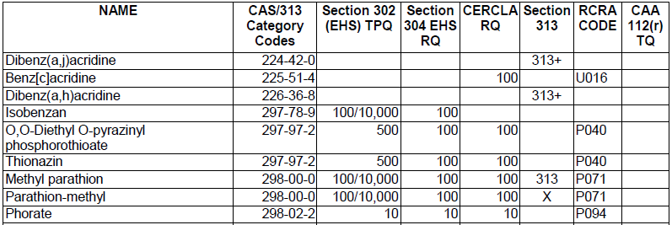
Section 302 - List of Lists
Section 302 (EHS) TPQ – Notification Requirement
If you have any EHS = to or > than TPQ, you must notify SERC & LEPC they are present at facility
Section 302 (EHS) TPQ – Annual Tier II Reporting
EHS substance is 500 lbs. or the TPQ, whichever is less

Slide 15
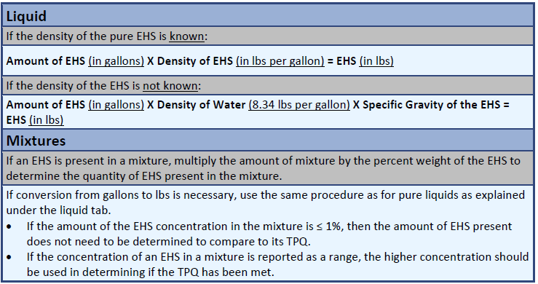
Calculating Liquids and Mixtures

Slide 16
Calculating Solids
Solid in Powdered Form (< 100 microns) – Multiply the % weight of the solid in powered form by the total weight of solid in the container.
Solid in Solution – Multiply the % weight of the non-reactive solid in solution by the total weight of solution in the container. Then multiply by 0.2.
Solid in Molten Form – Multiply the weight of the non-reactive solid in molten form by 0.3.

Slide 17
Section 303 Facility Requirements
Appoint a facility representative who can participate in planning process (facility contact)
Facility representative is expected to notify SERC, LEPC, & local fire department of changes. These changes may include:
Modification to the amount of chemicals stored
Changes in storage locations
Process changes
Changes in emergency contacts

Slide 18
Section 303 Emergency Response Plans
Requires LEPCs to prepare an emergency response plan for the district, and review annually.
This is done with information we collect from annual Tier II reporting (mostly EHS chemicals), and other sources.
We then train and exercise towards the hazards identified in the district.

Slide 19
Section 311 Safety Data Sheets (SDS)
OSHA estimates 880,000 chemicals with SDS
Chemicals at the facility under this section include:
Any EHS that meets/exceeds TPQ, or 500 lbs. at any one time, whichever is less
Any hazardous chemicals that meets/exceeds 10,000 lbs. at any one time for which OSHA requires an SDS to be maintained

Slide 20
Section 311 Safety Data Sheets (SDS)
Facilities must submit their list of chemicals
Must be done within 90 days
New Facility – submit list of all chemicals
New Chemical at Facility – submit SDS or updated list
Encourage facilities to submit summary documentation instead of SDS
(see Section 311 – Reporting Form)

Slide 21
Section 312 - Tier II Reporting
Same chemicals as Section 311
Must submit a Tier II Chemical Inventory Report for inventory of hazardous chemicals, quantities, locations & potential hazards
Reporting document for previous calendar year and is due March 1st , annually

Slide 22
Section 312 - Tier II Reporting
What must be reported?
EHS – 500lbs. or TPQ, whichever is lower
All other OSHA Chemicals – 10,000 lbs. or greater
Fuels:
Diesel* – 100,000 gallons or greater
Gasoline* – 75,000 gallons or greater
M85, E85, E95, #2 fuel oil, kerosene fall under 10,000 lbs. reporting threshold
*includes retail gas stations with underground tanks*

Slide 23
Section 312 - Tier II Reporting
Tier II reports must be sent to:
SERC
LEPC
Local Fire Department - Contact Fire Department and ask where the Tier II can be submitted
Jacksonville F/R – Chief Brian Peterson
brianp@coj.net
There are exemptions to reporting under Section 311 and 312; hazwaste, tobacco, wood/wood products, food, drugs, cosmetics, or alcoholic beverages, consumer product, etc.

Slide 24
Tier II Forms – Ways to Submit
SERC and LEPC – online at erplan.net
Check with Local Fire Department to determine their preferred method.
Some use E-Plan, others do not
If not filing online, then must send to SERC via hardcopy by mail
Check with LEPC and Local Fire Department for preferred method

Slide 25
Tier II - Fee Structure
One-time filing fee for Section 302 facilities (public or private): $50
Annual Registration fee for private facilities under Section 302 or 312: based on number of employees in State
$10/employee (min = $25, max = $2,000)
Variations for other regulated industries like Agriculture or Petroleum
Governmental bodies are exempt

Slide 26
Section 304 & CERCLA103 Release Notifications
Release notification must take place when chemical release meets or exceeds the Reportable Quantity (RQ) in a 24-hour period
Purpose is to notify all levels of government of hazard, and to prepare a response

Slide 27
Section 304 & CERCLA103 Release Notifications
Report must be made by facility owner or operator, or representative within 15 minutes
Notification from any other source (i.e., first responder, emergency management, etc.) will NOT satisfy the reporting requirement
Calling 911 will NOT satisfy reporting requirement, unless transportation incident

Slide 28
Section 304 & CERCLA103 Release Notifications
Who to call:
State Warning Point/State Watch Office
(850) 413-9911
If CERCLA release, call National Response Center
1-800-424-8802
Notify the LEPC after you have made the notification calls to the above.
Northeast Florida LEPC - (904) 279-0880 ext. 108

Slide 29
Section 304 & CERCLA103 Release Notifications
Notification includes:
Chemical name; and is it an EHS?
Estimated quantity of release
Time and duration
Medium into which release occurred (ground/water/air)
Known or anticipated health risks
Any evacuation or other precautions
Name and telephone number of contact

Slide 30
Section 304 & CERCLA103 Release Notifications
Failure to report could result in substantial penalty
When in doubt…call SWO anyway. Reference number will be issued
Once situation is under control, engineering reports complete, call back to update SWO
If it is a Section 304 release must send follow-up report within 7 days

Slide 31
Other EPCRA Sections
Section 322: Trade Secrets
Section 323: Provision of information to health professionals, doctors, & nurses
Section 324: Public availability of plans, data sheets, forms, & follow-up notices
Section 325: Enforcement
Section 326: Civil Actions

Slide 32
Section 325 - Enforcement
Civil and administrative penalties (release/spill)
$37,500/day or per violation/day
$107,500 for 2nd or subsequent violations
Criminal penalties (release/spill)
Up to $25,000 or/and 2-years in prison
$50,000 or/and 5-years for 2nd conviction
Failure to report annual Tier II Report
$37,500/day

Slide 33
Section 326 – Civil Actions
Government or citizens can take action against a facility for failure to comply.
Can bring action for failure to:
Submit a follow-up report of an emergency release
Submit a list of chemicals
Submit a Tier II form

Slide 34
Summary
Legislation in reaction to chemical release
Purpose of law is to prevent loss of life, protection of citizens’ property, and increase public awareness
Depending on the chemicals at your Facility, you may be subject to reporting requirements under EPCRA
Tier II’s and Annual Registration fees due each year by March 1st
Enforcement and Civil Actions for no compliance

Slide 35
Important Numbers / Addresses
State Emergency Response Commission
Robert Dietrich - Technological Hazards Manager
Florida Division of Emergency Management
Office: (850)815-4326 , Mobile: (850)727-3414
National Response Center (800) 424-8802
Florida State Watch Office (850) 413-9911 (800) 320-0519

Slide 36
Questions?
Tyler Nolen
Northeast Florida LEPC Coordinator
tnolen@nefrc.org
Northeast Florida LEPC
100 Festival Park Avenue
Jacksonville, Florida 32202
O: (904) 279-0880 ext: 108
F: (904) 279-0881

