Slide 1
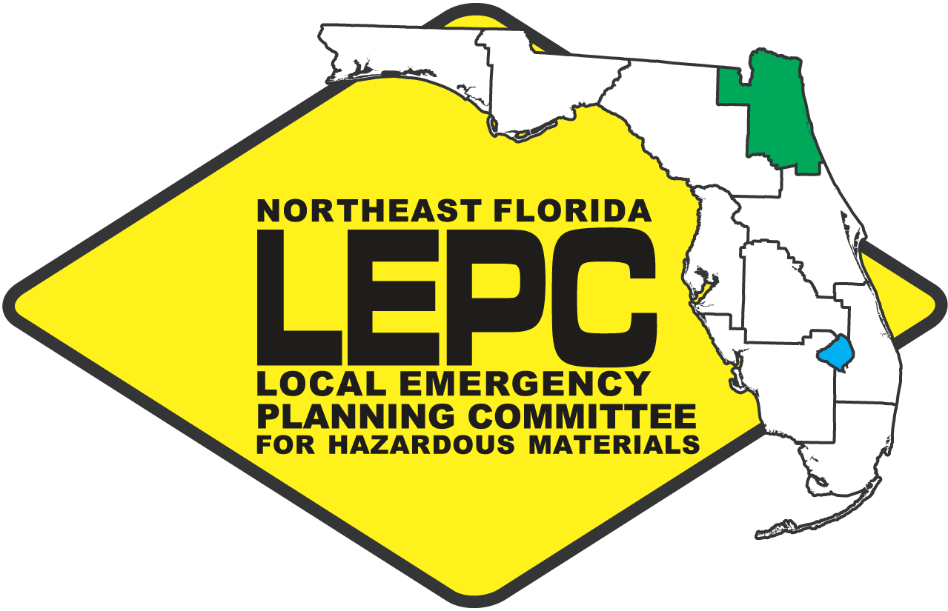
Local Emergency Planning Committee for Hazardous Materials
An overview of the
LEPC framework and activities

Slide 2
Agenda
LEPC Framework (Statute/EPCRA)
LEPC HazMat Training and Exercises
Tier II Reporting – Chemical Inventory Reports
General Requirements
Changes for Reporting
Tier II Information for Emergency Planning

Slide 3
History
EPCRA was passed in response to 2 major events
Bhopal, India Disaster
December, 1984
Methyl Isocyanate – 500,000+ exposed (2000+ dead)
Worst Industrial Accident in History
Institute, West Virginia
August, 1985
Methylene Chloride & Aldicarb Oxime
134 people to hospital
Notes:
Union Carbide India Limited pesticide plant; over 500,000 people were exposed. Estimates vary on the death toll, but the official immediate deaths were 2,259. Other deaths in the weeks following are anywhere from 3,000 to 16,000. Injuries included 558,125 with 38,478 temporary partial injuries and 3,900 severely and permanently disabling injuries.

Slide 4
Federal & State Legislation
Superfund Amendments and Reauthorization Act of 1986 (SARA Title III)
Florida EPCRA, 1988 – FL Statute: Chapter 252, Part II

Slide 5
EPCRA
Subchapter A: Emergency Planning and notification of a hazardous materials incident (Sections 301 – 304)
Subchapter B: Reporting of hazardous chemical inventories and toxic release inventory reports (Sections 311 – 313)
Subchapter C: Administration, enforcement, & trade secret protection (Sections 321-330)

Slide 6
EPCRA Purpose
Encourages and requires coordination between industry, government, and the public
Requires information be accessible to the public
Authorizes penalties for not complying with EPCRA
Empowers private citizens groups to file enforcement lawsuits for failure to comply

Slide 7
Section 301- SERC
Establishes Organizational Framework
Establishes the State Emergency Response Commission
Group of Stakeholders (Public, Private, & Gov’t)
Meets Quarterly
Policy Group
Staffed by the Florida Division of Emergency Management (FDEM)

Slide 9
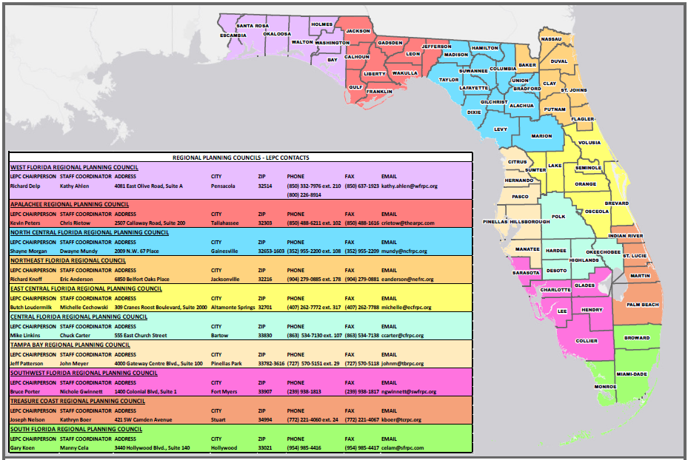
Section 301 – LEPC

Slide 10
What is the LEPC?
Repository for regional hazardous materials info
Broad based membership
Firefighting, Facility Owners/Operators, Health, Transportation, Environmental, Law Enforcement, Community Groups, Interested Citizens, Media, Hospitals, & Emergency Mgmt.
Emergency planning
First responder training
Public education and awareness

Slide 11
Statutory/Contractual
Services
Hazards Analysis Site Visits
LEPC Organizational Functions
Tier II Reporting
LEPC HazMat Response Plan
Technical Assistance
Training/Exercises for Public and Private Entities
Public Outreach
HazMat Awareness Week
“How to Comply” Workshops
E-Plan Electronic Tier II Filing

Slide 12
Section 302 Substances & Notification
Purpose of Section 302 is to establish and identify a list of substances and gather information on facilities of most concern for emergency planning and response
That list is known as the EPA’s “List of Lists”
Focus on Extremely Hazardous Substances (EHS)

Slide 13
Section 303 Emergency Response Plans
Requires LEPCs to prepare an emergency response plan for the district, and review annually.
This is done with information we collect from annual Tier II reporting (mostly EHS chemicals), an other sources.
We then train and exercise towards the hazards identified in the district.

Slide 14
Section 303 Facility Requirements
Appoint a facility representative who can participate in planning process (facility contact)
Facility representative is expected to notify SERC, LEPC, & local fire department of changes. These changes may include:
Modification to the amount of chemicals stored
Changes in storage locations
Process changes
Changes in emergency contacts

Slide 15
Accidents Still Happen
Although we have a regulatory framework and chemical reporting system in place, accidents still happen.
Examples:
T-2 Laboratories in Jacksonville
West, Texas Fertilizer Plant Explosion

Slide 16
Executive Order 13650
West, Texas explosion led to Executive Order 13650 in August 2013.
The focus of the EO is to reduce risks associated with hazardous chemicals to owners and operators, workers, and communities by enhancing the safety and security of chemical facilities.
More communication and shared information throughout levels of government.

Slide 17
Agenda
LEPC Framework (Statute/EPCRA)
LEPC HazMat Training and Exercises
Tier II Reporting – Chemical Inventory Reports
General Requirements
Changes for Reporting
Tier II Information for Emergency Planning

Slide 18
2015/16 Accomplishments
Three Exercises with Regional HazMat Teams
Clay County Fire/Rescue
Jacksonville Fire/Rescue
St. Johns County Fire/Rescue
“ How to Comply” & E-Plan Workshops
Attended by 100+ people
HazMat Training (FY 2015-2016)
19 classes, 361 people trained, $150.48/person

Slide 19
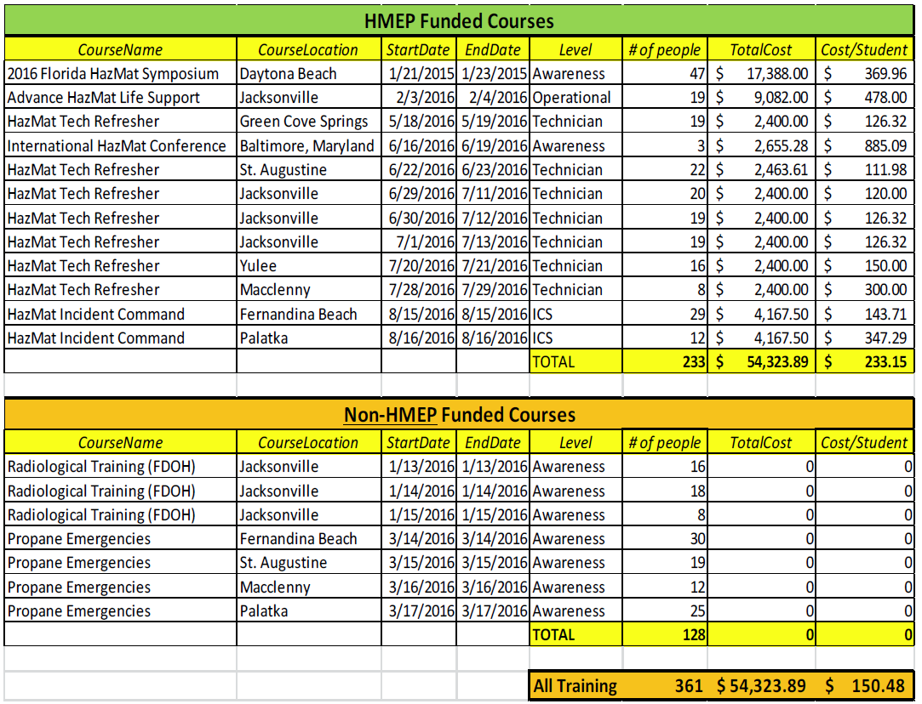
2015/16 Training

Slide 20
Current Exercise Planning
Partnering with CSX on a Train Accident Exercise
CSX will bring in their Safety Train
4 Regional HazMat Teams will Participate
Clay County Fire/Rescue
Jacksonville Fire/Rescue
St. Johns County Fire/Rescue
Occur April 7th in Green Cove Springs

Slide 21
Agenda
LEPC Framework (Statute/EPCRA)
LEPC HazMat Training and Exercises
Tier II Reporting – Chemical Inventory Reports
General Requirements
Changes for Reporting
Tier II Information for Emergency Planning

Slide 22
EPCRA Documents & How to Comply Manual
http://www.floridadisaster.org/hazmat/SERC/EPCRA.htm

Slide 23
Section 311 Safety Data Sheets (SDS)
OSHA estimates 880,000 chemicals with SDS
Chemicals at the facility under this section include:
Any EHS that meets/exceeds TPQ, or 500 lbs. at any one time, whichever is less
Any hazardous chemicals that meets/exceeds 10,000 lbs. at any one time for which OSHA requires an SDS to be maintained

Slide 24
Section 311 Safety Data Sheets (SDS)
Facilities must submit their list of chemicals
Must be done within 90 days
New Facility – submit list of all chemicals
New Chemical at Facility – submit SDS or updated list
Encourage facilities to submit summary documentation instead of SDS
(see Section 311 – Reporting Form)

Slide 25
Section 312 - Tier II Reporting
Same chemicals as Section 311
Must submit a Tier II Chemical Inventory Report for inventory of hazardous chemicals, quantities, locations & potential hazards
Reporting document for previous calendar year and is due March 1st , annually

Slide 26
Section 312 - Tier II Reporting
What must be reported?
EHS – 500lbs. or TPQ, whichever is lower
All other OSHA Chemicals – 10,000 lbs. or greater
Fuels:
Diesel* – 100,000 gallons or greater
Gasoline* – 75,000 gallons or greater
M85, E85, E95, #2 fuel oil, kerosene fall under 10,000 lbs. reporting threshold
*includes retail gas stations with underground tanks*

Slide 27
Section 312 - Tier II Reporting
Tier II reports must be sent to:
SERC
LEPC
Local Fire Department
*Contact Fire Department and ask where the Tier II can be submitted
There are exemptions to reporting under Section 311 and 312; hazwaste, tobacco, wood/wood products, food, drugs, cosmetics, or alcoholic beverages, consumer product, etc.

Slide 28
Tier II Forms – Ways to Submit
SERC and LEPC – online at erplan.net
Check with Local Fire Department to determine their preferred method.
Some use E-Plan, others do not
If not filing online, then must send to SERC via hardcopy by mail
Check with LEPC and Local Fire Department for preferred method

Slide 29
Changes to Tier II Reporting
State Specific Information:
Does your facility have a written emergency response plan? Yes or No
Does your facility have a hazardous materials response team? Yes or No
Does your local fire department have an up-to-date pre-plan for your facility? Yes or No
Optional in 2016, Mandatory in 2017
Upload Facility Site Plan

Slide 30
Section 304 & CERCLA103 Release Notifications
Who to call:
State Warning Point/State Watch Office
(850) 413-9911
If CERCLA release, call National Response Center
1-800-424-8802
Notify the LEPC after you have made the notification calls to the above.
Northeast Florida LEPC - (904) 279-0880 ext. 178

Slide 31
Section 304 & CERCLA103 Release Notifications
Notification includes:
Chemical name; and is it an EHS?
Estimated quantity of release
Time and duration
Medium into which release occurred (ground/water/ air)
Known or anticipated health risks
Any evacuation or other precautions
Name and telephone number of contact

Slide 32
Other EPCRA Sections
Section 322: Trade Secrets
Section 323: Provision of information to health professionals, doctors, & nurses
Section 324: Public availability of plans, data sheets, forms, & follow-up notices
Section 325: Enforcement
Section 326: Civil Actions

Slide 33
Section 325 - Enforcement
Civil and administrative penalties (release/spill)
$37,500/day or per violation/day
$107,500 for 2nd or subsequent violations
Criminal penalties (release/spill)
Up to $25,000 or/and 2-years in prison
$50,000 or/and 5-years for 2nd conviction
Failure to report annual Tier II Report
$37,500/day

Slide 34
Section 326 – Civil Actions
Government or citizens can take action against a facility for failure to comply.
Can bring action for failure to:
Submit a follow-up report of an emergency release
Submit a list of chemicals
Submit a Tier II form

Slide 35
Summary
Legislation in reaction to chemical release
Purpose of law is to prevent loss of life, protection of citizens’ property, and increase public awareness
Depending on the chemicals at your Facility, you may be subject to reporting requirements under EPCRA
Tier II’s and Annual Registration fees due each year by March 1st
Enforcement and Civil Actions for no compliance

Slide 36
Important Numbers / Addresses
State Emergency Response Commission 2555 Shumard Oak Boulevard Tallahassee, Florida 32399-2100 (800) 635-7179 (Florida only) (850) 413-9970
National Response Center (800) 424-8802
Florida State Watch Office (850) 413-9911 (800) 320-0519

Slide 37
Agenda
LEPC Framework (Statute/EPCRA)
LEPC HazMat Training and Exercises
Tier II Reporting – Chemical Inventory Reports
General Requirements
Changes for Reporting
Tier II Information for Emergency Planning

Slide 38
Tier II for Emergency Planning
Collect Tier II reports
Complete site visits to verify information
Conduct Hazards Analysis
Verify facility contacts and information
Model worst case scenario per EHS chemical
Develop vulnerability maps
Identify critical facilities in the VZ
Pre-plan a response to the facility

Slide 39
We Reviewed
LEPC Framework (Statute/EPCRA)
LEPC HazMat Training and Exercises
Tier II Reporting – Chemical Inventory Reports
General Requirements
Changes for Reporting
Tier II Information for Emergency Planning

Slide 40
Questions
Eric Anderson, NEFL LEPC Coordinator
Northeast Florida Regional Council
100 Festival Park Avenue
Jacksonville, Florida 32206
(904) 279-0880
eanderson@nefrc.org

